Slide 1
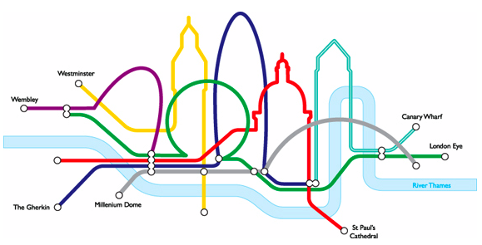
TFL Database Project
Dylane Menga

Slide 2
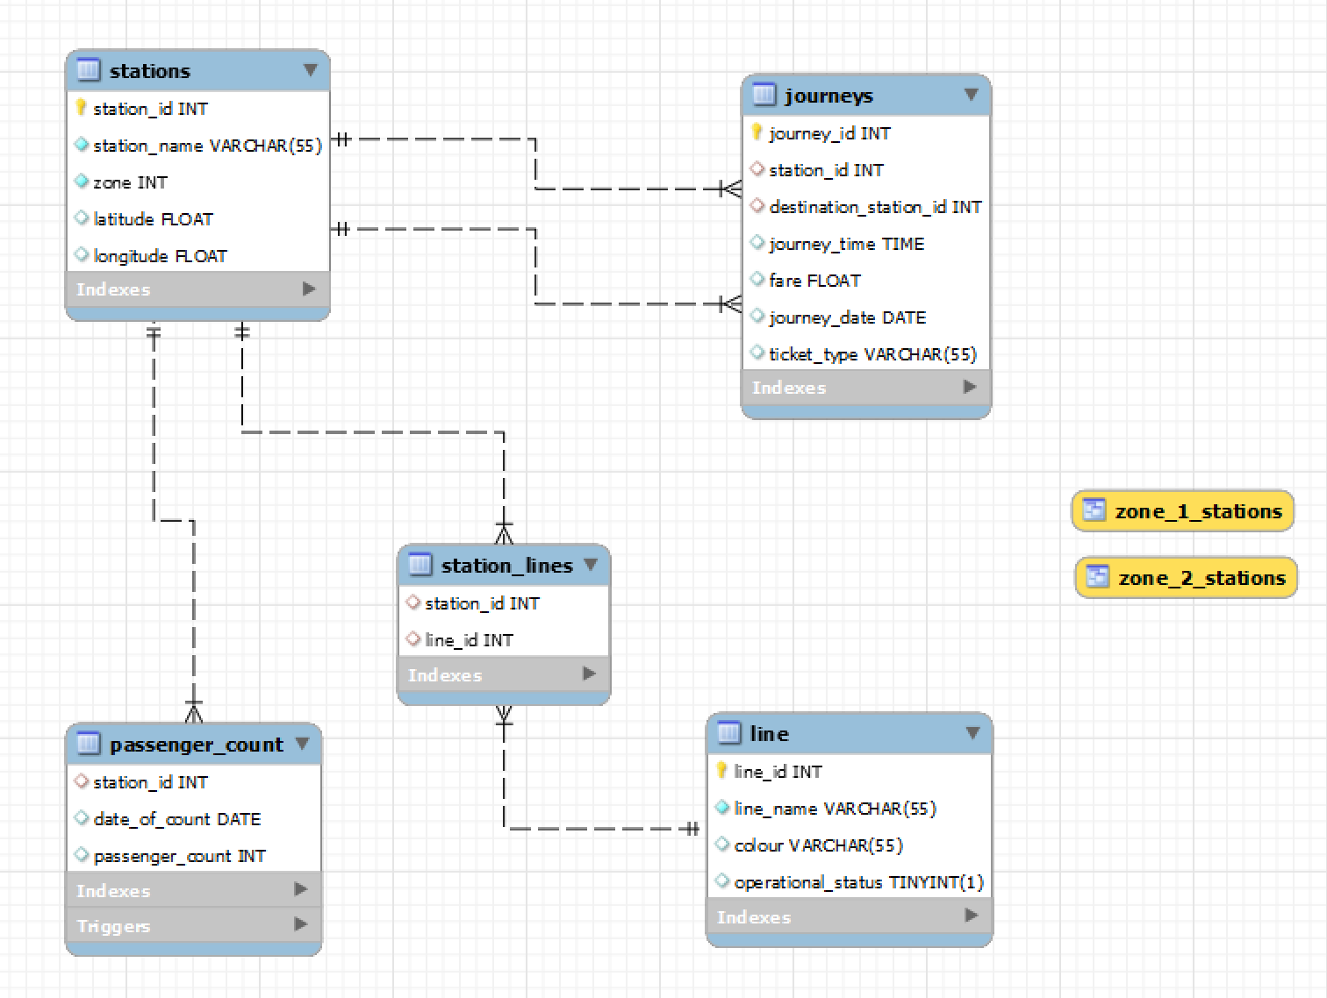
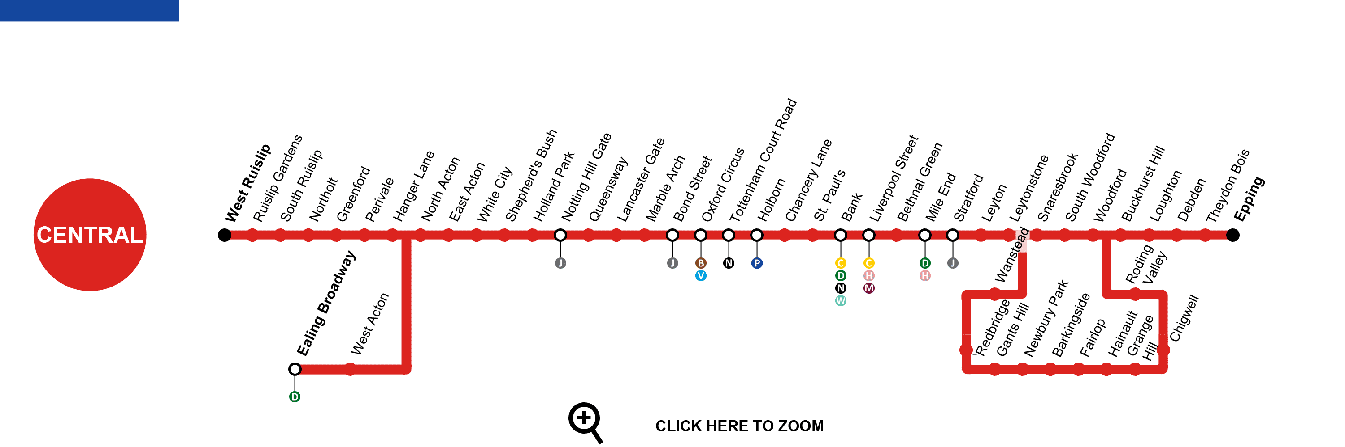
Five tables, to connect data about the London Underground: Stations Tube Lines Station Lines Journeys Passenger Count

Slide 3
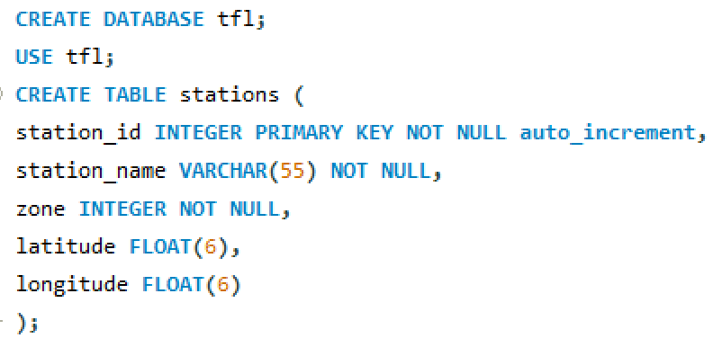
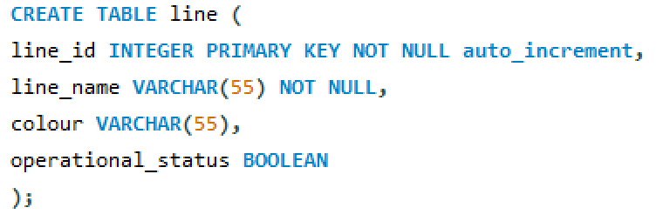
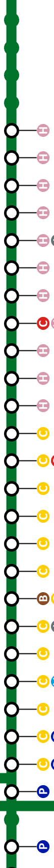
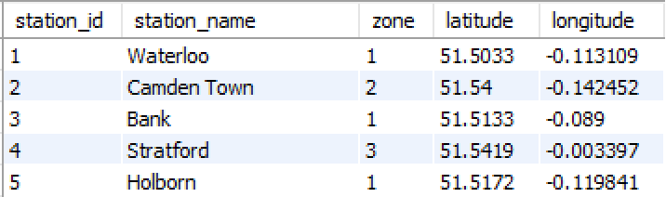
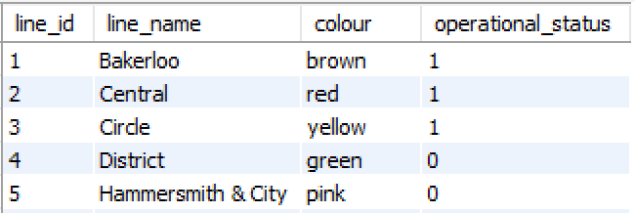
Stations Table
Line Table

Slide 4
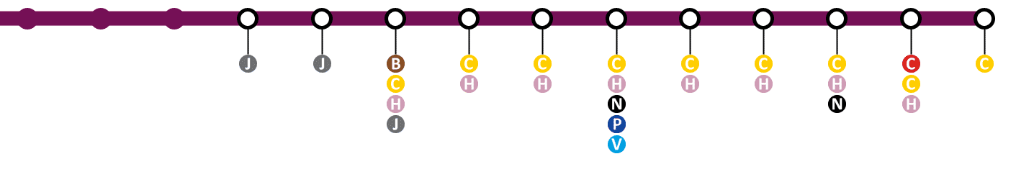
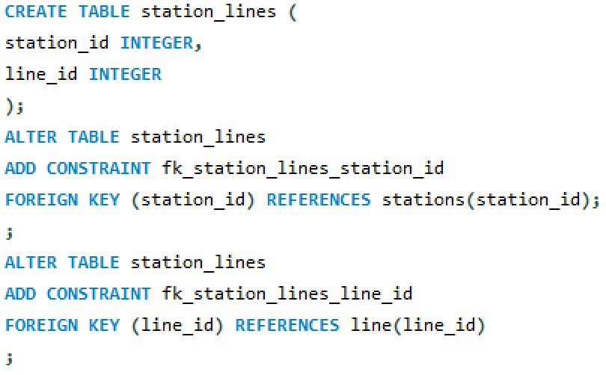
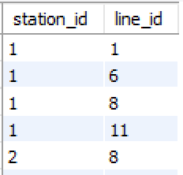
Station Lines Table
Where stations have multiple lines, I entered a single data row for each line at each station.

Slide 5
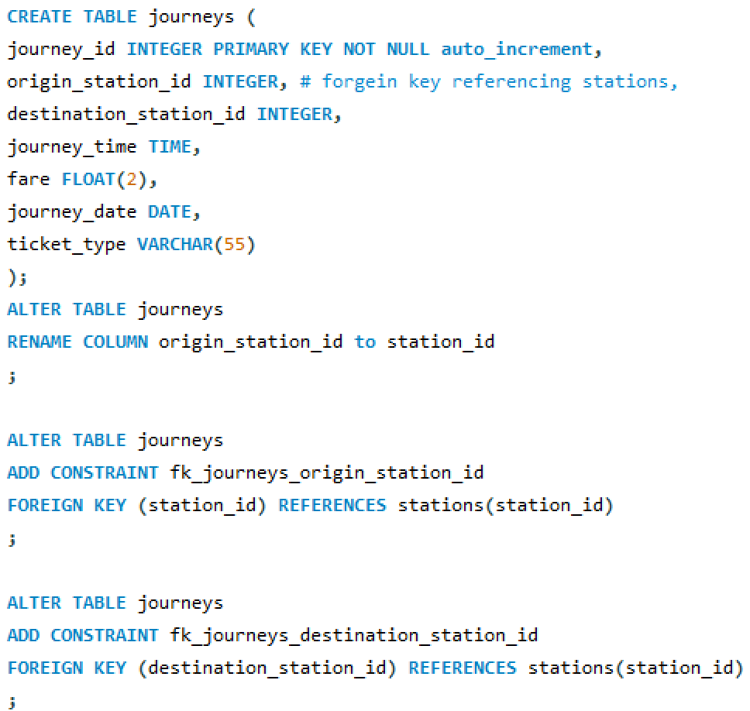
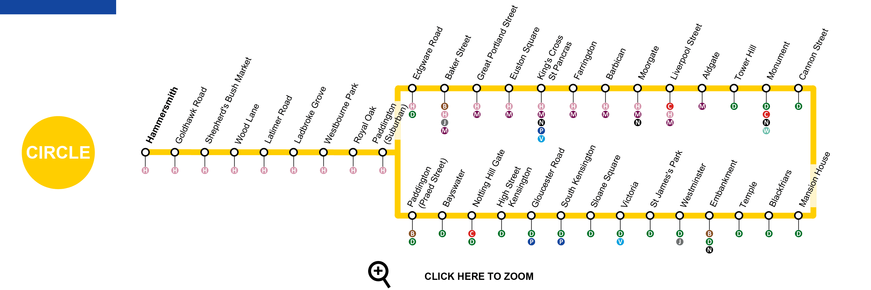
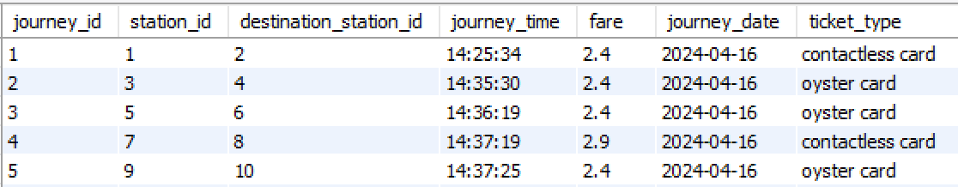
Journeys Table

Slide 6
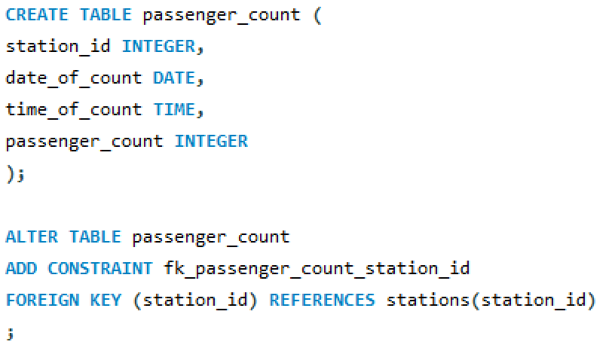
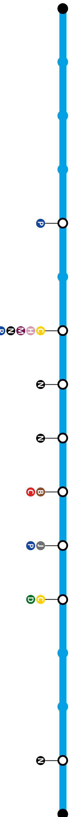
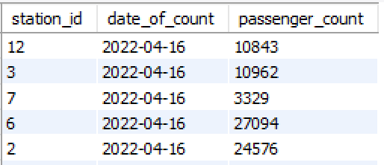
Passenger Count Table

Slide 7
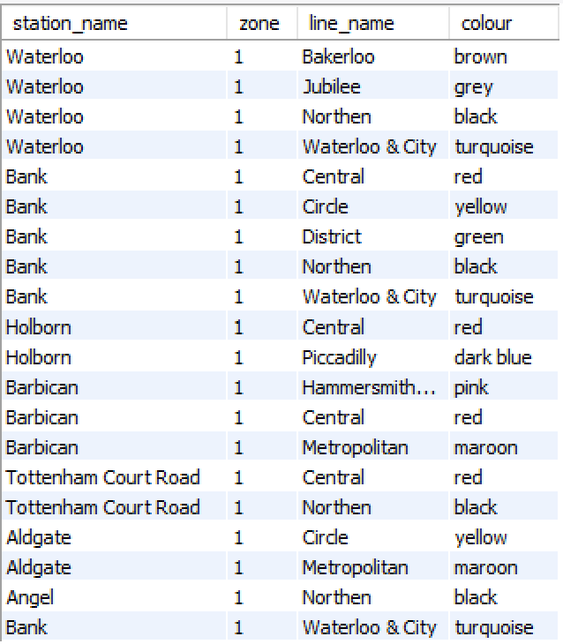
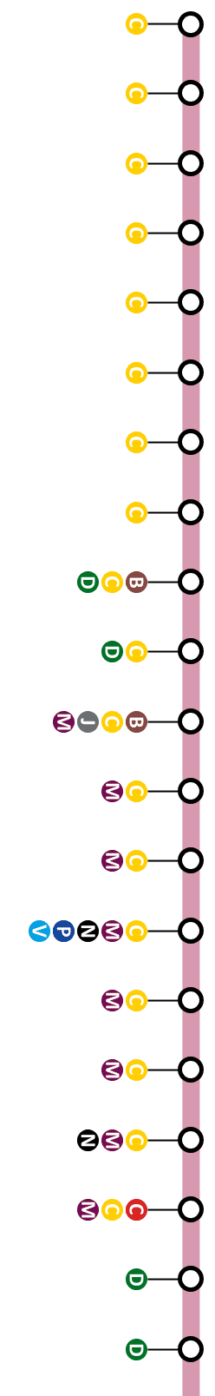
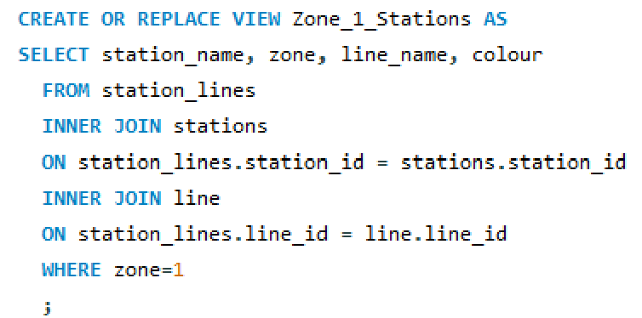

View
I decided to create a view that will show all Zone 1 stations and include information about them: Station Name Station Zone Line Name Line Colour
This joins the stations, station lines and line table to collate the information with two inner joins.
Notes:
The Join uses the station_id column on the stations table and the station_lines table.
There is an inner join to join the line_id column with station_lines table and line table.

Slide 8
Stations Table
Station_lines Table
Line Table
Station_id
Line_id
Notes:
The Join uses the station_id column on the stations table and the station_lines table.
There is an inner join to join the line_id column with station_lines table and line table.

Slide 9
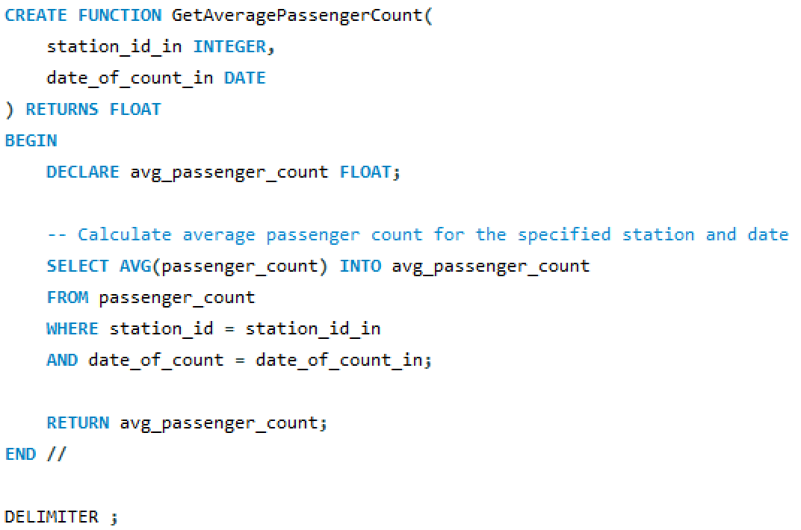
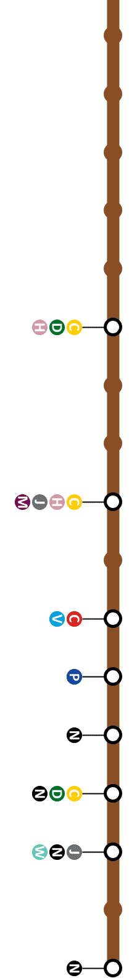

Stored Function
This stored function gets the average passenger count on a selected date and for a selected station.
Notes:
I named this function Get Average Passenger Count
It uses the station_id which is declared as an integer and the date_of_count which is a date format.
The results could be a decimal number, so I have used ‘returns float’
I have used the SELECT AVG function to calculate the average of the passenger_count column
And then assign the variable ‘average_passenger_count’ to the results

Slide 10
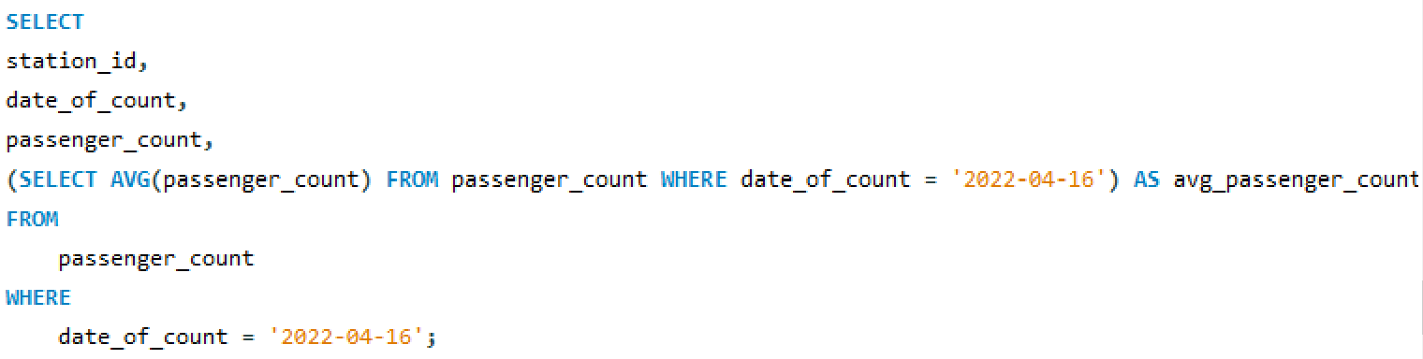
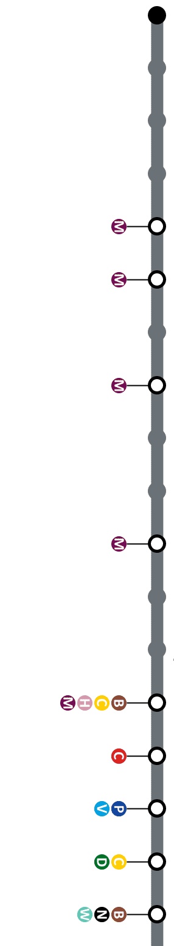
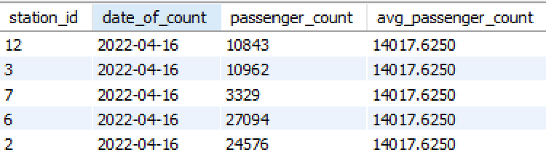
Subquery
Notes:
This subquery calculates the average passenger count for the date '2022-04-16' from the passenger_count table.
It's used as a column in the outer SELECT statement to display the average passenger count alongside other columns selected from the passenger_count table.

Slide 11
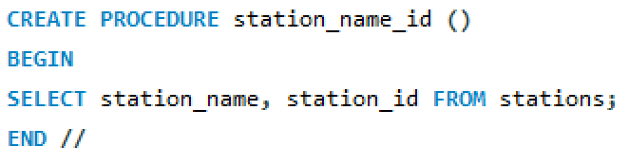

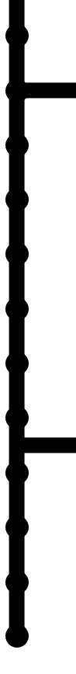
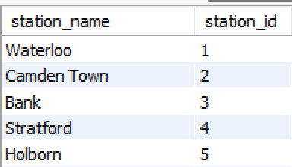
Stored Procedure
Notes:
CREATE PROCEDURE station_name_id (): This statement creates a new stored procedure named station_name_id with no parameters.
BEGIN: This marks the beginning of the procedure's body.
SELECT station_name, station_id FROM stations;: This SQL query selects the station_name and station_id columns from the stations table. It retrieves all rows and columns from the stations table.
END //: This marks the end of the procedure's body, and // is used as the delimiter to signify the end of the procedure definition.

Slide 12
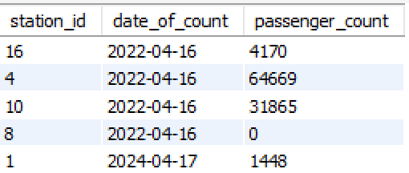
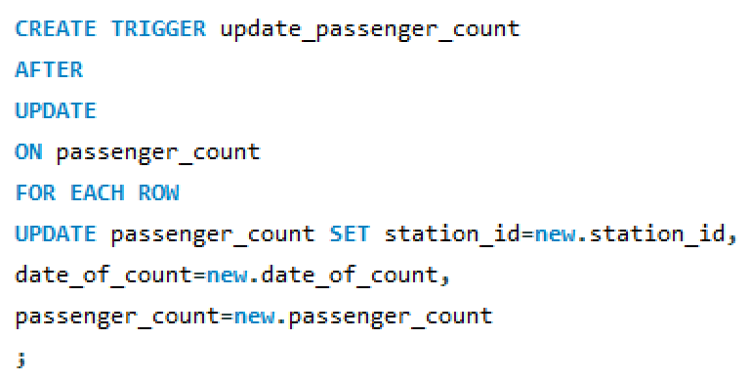
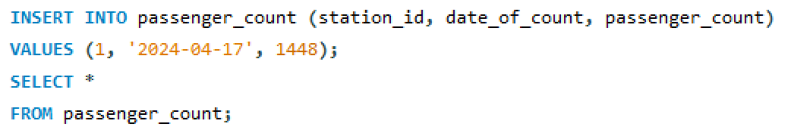
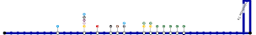
Trigger
Notes:
AFTER UPDATE ON passenger_count: This specifies that the trigger should activate after an UPDATE operation is performed on the passenger_count table.
FOR EACH ROW: This indicates that the trigger will be executed for each row affected by the UPDATE operation.
UPDATE passenger_count SET ...: This is the action performed by the trigger. It updates the passenger_count table.
SET station_id=new.station_id, date_of_count=new.date_of_count, passenger_count=new.passenger_count: This specifies the columns to be updated in the passenger_count table.
station_id=new.station_id: This sets the station_id column in the passenger_count table to the new value (new.station_id) provided by the UPDATE operation.
date_of_count=new.date_of_count: This sets the date_of_count column in the passenger_count table to the new value (new.date_of_count) provided by the UPDATE operation.
passenger_count=new.passenger_count: This sets the passenger_count column in the passenger_count table to the new value (new.passenger_count) provided by the UPDATE operation.

Slide 13
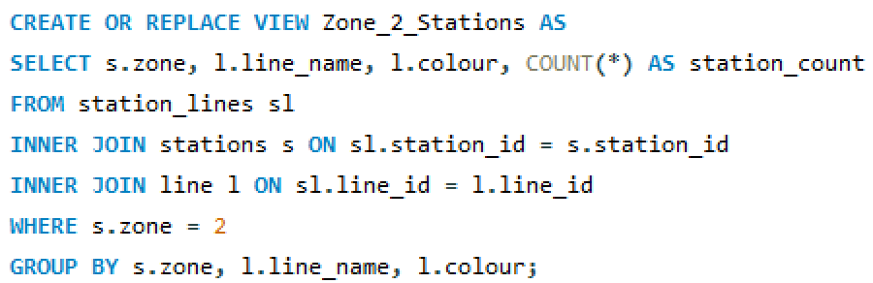
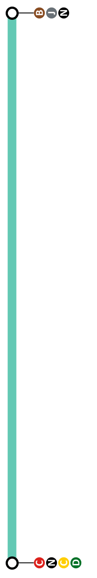
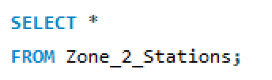
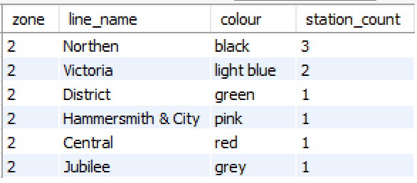
Second View
Notes:
Joins the stations, station_lines and lines tables to gather a view of zone two stations and grouping them by their line and colour.
Views are virtual tables that are generated based on the result of a SELECT query.
SELECT s.zone, l.line_name, l.colour, COUNT(*) AS station_count: This SELECT statement retrieves data from the tables involved in the view creation. It selects the zone, line name, and line colour from the stations and line tables, along with a count of stations for each combination of zone, line name, and line colour.
FROM station_lines sl INNER JOIN stations s ON sl.station_id = s.station_id INNER JOIN line l ON sl.line_id = l.line_id: This part of the query specifies the tables involved in the query and how they are joined. It joins the station_lines, stations, and line tables based on their respective keys (station_id and line_id).
WHERE s.zone = 2: This WHERE clause filters the rows to include only those where the zone is equal to 2. This restricts the results to stations in zone 2.
GROUP BY s.zone, l.line_name, l.colour: This GROUP BY clause groups the results by the specified columns (s.zone, l.line_name, l.colour). This is necessary because an aggregate function (COUNT) is used in the SELECT statement. It ensures that the COUNT is calculated for each unique combination of zone, line name, and line colour.

Slide 14
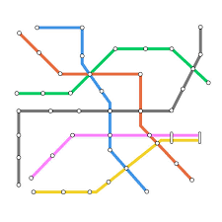
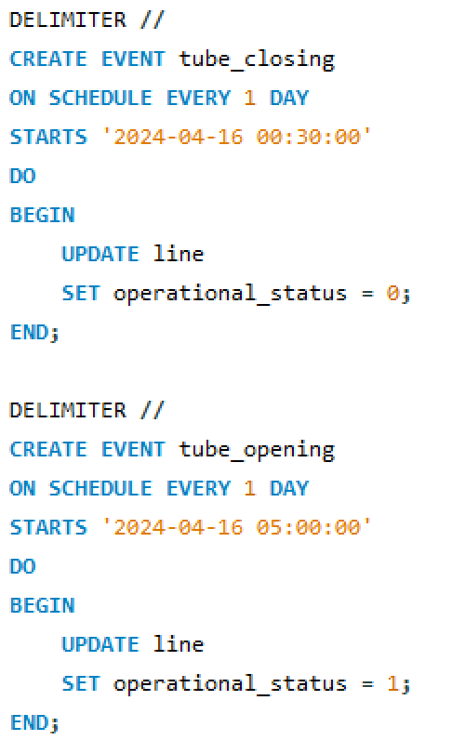
Event Scheduler
Notes:
ON SCHEDULE EVERY 1 DAY: This specifies that the event should occur every day.
STARTS '2024-04-16 00:30:00': This specifies the start time for the event, which is set to '2024-04-16 00:30:00'.
DO BEGIN ... END: This marks the beginning and end of the event's body. The code inside the BEGIN and END block will be executed when the event is triggered.
UPDATE line SET operational_status = 0;: This SQL statement updates the operational_status column in the line table, setting it to 0. This effectively simulates the closing of the tube system.
these events schedule two recurring tasks: one to close the tube system every day at 00:30:00 and another to open it every day at 05:00:00

